Slide 1
Field Simulator Verification Procedure
By: William Poole

Slide 2
File Method
Shape_Maker->Solenoid Shape Maker [Rectangle, Rriangle, Trumpet]
Passes Point_3d to Field_Maker
Field_Maker->Uses Point_3d to map path for length of wire, receives current and data map to generate B and H field

Slide 3
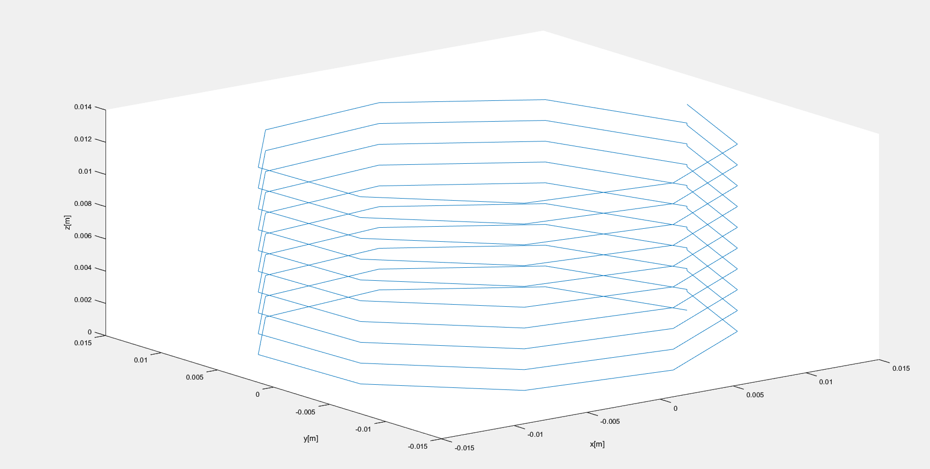
Shape For Testing
Rectangle 10turns, 1 layer, radius init 12.7mm, AWG 16, 100 points

Slide 4
Starting Points
Points are stored as [1,1,:]=x, [1,2,:]=y, [1,3,:]=z
Point_3d[:,:,1]= 0.0133,0,0.0001 | [x,y,z]
Point_3d[:,:,2]=0.0102,0.0086,0.0003 | [x,y,z]
dl=Point_3d[:,:,2]-Point_3d[:,:,1]
dl (Vector)=-0.0031,0.0086,0.0002, represents path of current

Slide 5
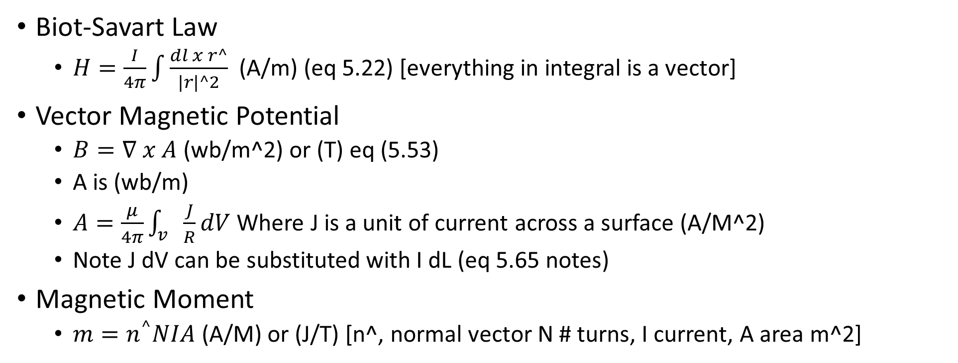
Equations
Biot-Savart Law
$H=\frac{I}{4π}\int{\frac{dl x r^}{|r|^2}}$ (A/m) (eq 5.22) [everything in integral is a vector]
Vector Magnetic Potential
$B=∇ x A$ (wb/m^2) or (T) eq (5.53)
A is (wb/m)
$A=\frac{μ}{4π}\int_{v}{\frac{J}{R}dV}$ Where J is a unit of current across a surface (A/M^2)
Note J dV can be substituted with I dL (eq 5.65 notes)
Magnetic Moment
$m=n^{^}NIA$ (A/M) or (J/T) [n^, normal vector N # turns, I current, A area m^2]
Note _^ means unit vector, |_| abs(_),d_ integrate along _ {dl length, dV volume}

Slide 6

Equations Continued
U$=−(m∙B)$
$F=∇(m∙B)$

Slide 7
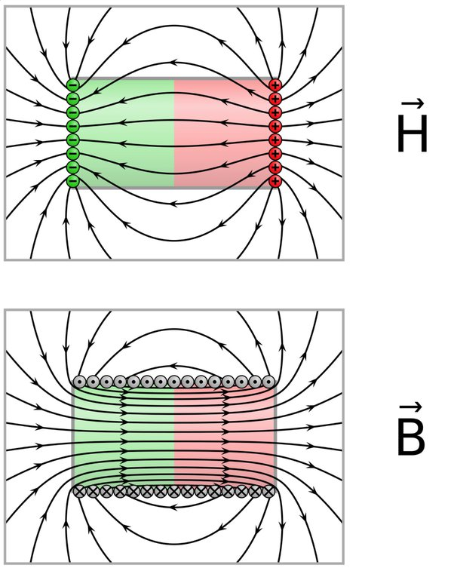
Knowns Initial
B-field and H-field should be similar on the “outside” of magnetic structures but differ on the inside.
This is due to
B=u_0(H+M)

Slide 8
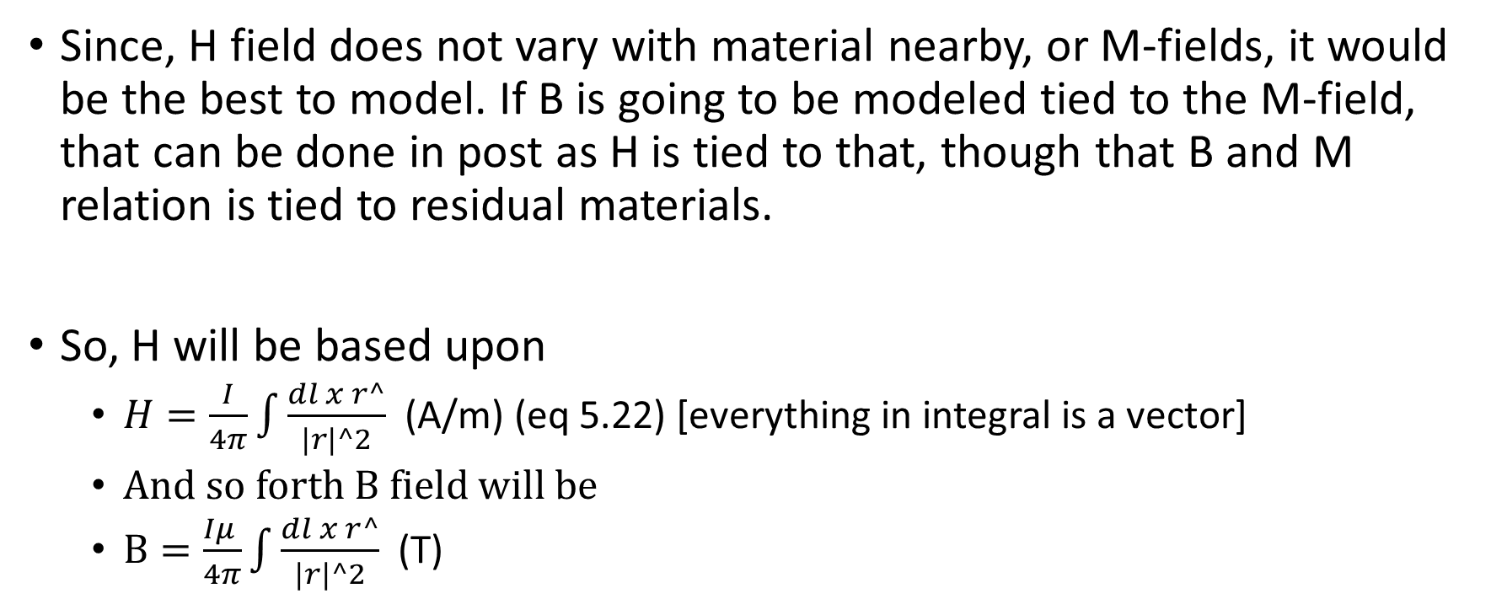
Simple Solution for modeling
Since, H field does not vary with material nearby, or M-fields, it would be the best to model. If B is going to be modeled tied to the M-field, that can be done in post as H is tied to that, though that B and M relation is tied to residual materials.
So, H will be based upon
$H=\frac{I}{4π}\int{\frac{dl x r^}{|r|^2}}$ (A/m) (eq 5.22) [everything in integral is a vector]
And so forth B field will be
$B=\frac{Iμ }{4π}\int{\frac{dl x r^}{|r|^2}}$ (T)

Slide 9
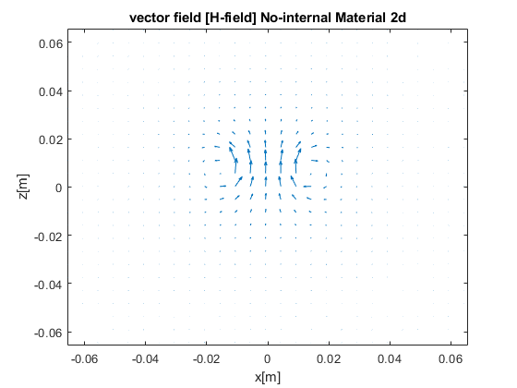
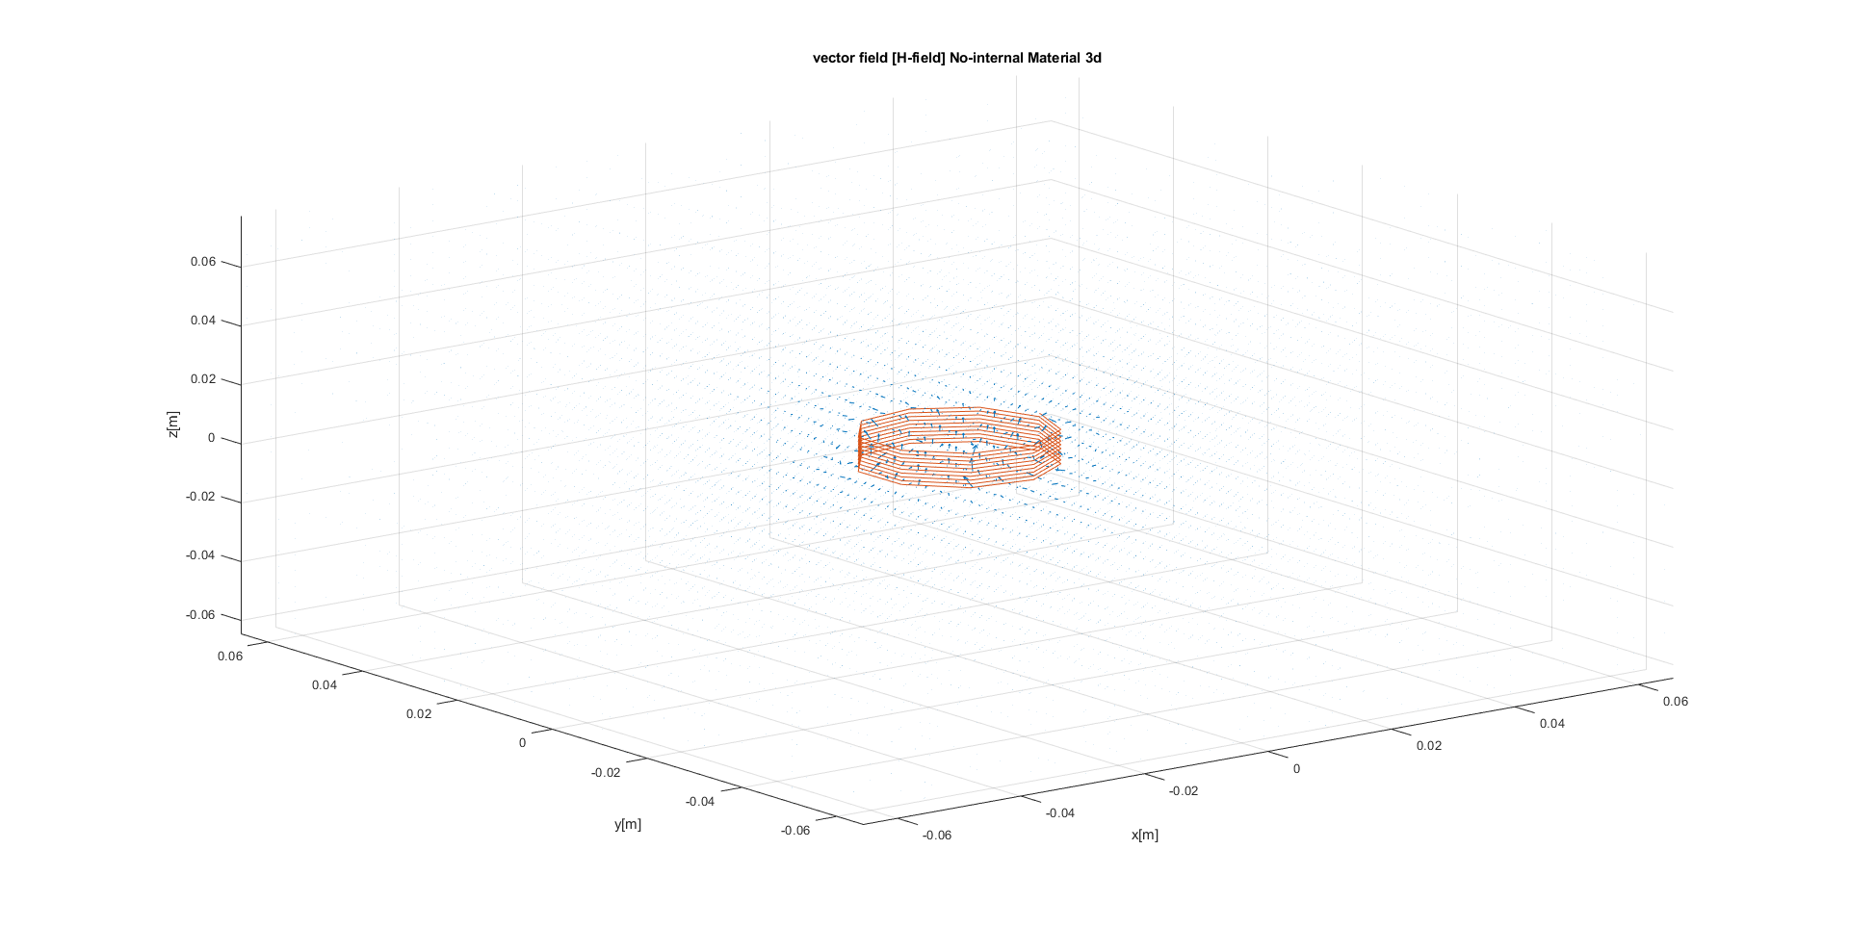
H-Field Model

